Slide 1
HIV Prioritization tool Version 1
Anna Grimsrud 8 April 2021

Slide 2
Objective
To provide an interactive tool that can be used as a discussion aid to support decision makers in planning/prioritizing HIV services by comparing trade-offs in impact and budget under different coverage levels of HIV services across the care cascade

Slide 3
Approach
Start with minimum viable product (MVP)
Describe a set of initial core interventions across prevention, testing and treatment categories
For each, estimate cost as well as impact on six core outcomes : adult infections, infant infections, 1st 95, 2nd 95, 3rd 95
Incorporate into platform which allows users to change coverage (or absolute number of people) impacted by interventions and visually explore effects (see slides which follow)
Incorporate feedback from users (throughout) and at a later stage potentially update intervention list

Slide 4
What‘s Included: Prevention
 | Outcome affected
intervention | adult infections | infant infections | first 95 | second 95 | third 95 | mortality
Infant prophylaxis |  | X
PEP | X
Condom availability | X
PrEP (oral) | X
PrEP (Lenacapavir) | X
VMMC | X

Slide 5
What‘s Included: Testing
 | Outcome affected
intervention | adult infections | infant infections | first 95 | second 95 | third 95 | mortality
Testing: facility-based (general) |  |  | X | X | X
Testing: facility-based (targeted) |  |  | X | X | X
Testing: Network/Index |  |  | X | X | X
Testing: community-based |  |  | X | X | X
Testing: for key populations & STI services |  |  | X | X | X
HIVST (Facility-based) |  |  | X | X | X
HIVST (community-based) |  |  | X | X | X

Slide 6
What‘s Included: Testing
 | Outcome affected
intervention | adult infections | infant infections | first 95 | second 95 | third 95 | mortality
Testing: facility-based (general) |  |  | X | X | X
Testing: facility-based (targeted) |  |  | X | X | X
Testing: Network/Index |  |  | X | X | X
Testing: community-based |  |  | X | X | X
Testing: for key populations & STI services |  |  | X | X | X
HIVST (Facility-based) |  |  | X | X | X
HIVST (community-based) |  |  | X | X | X

Slide 7
What‘s Included: Treatment
Conversation with Jeff Eaton
Leigh Johnson 2019 paper
Giguere et al 2021 Lancet HIV paper
HTS-POS targets, Malawi
Reflection on discussion with Karen Jennings
PEPFAR data, Brian Honerman
Chamie et al 2021 Lancet HIV paper
UNAIDS data on first and second 90s

Slide 8
What‘s Included: Treatment
Conversation with Jeff Eaton
Leigh Johnson 2019 paper
Giguere et al 2021 Lancet HIV paper
HTS-POS targets, Malawi
Reflection on discussion with Karen Jennings
PEPFAR data, Brian Honerman
Chamie et al 2021 Lancet HIV paper
UNAIDS data on first and second 90s

Slide 9
1. Jeff Eaton
We’ve made progress on the “retesting” point – that those who have been previously diagnosed but are on not on treatment require HIV testing. Need to somehow attach a value to finding those who’ve been previously diagnosed.
Testing needs to be not about restricting access, but looking at who to invest in going and findings vs. testing those who present
Testing is cheap, testing those who don’t need it is expensive

Slide 10
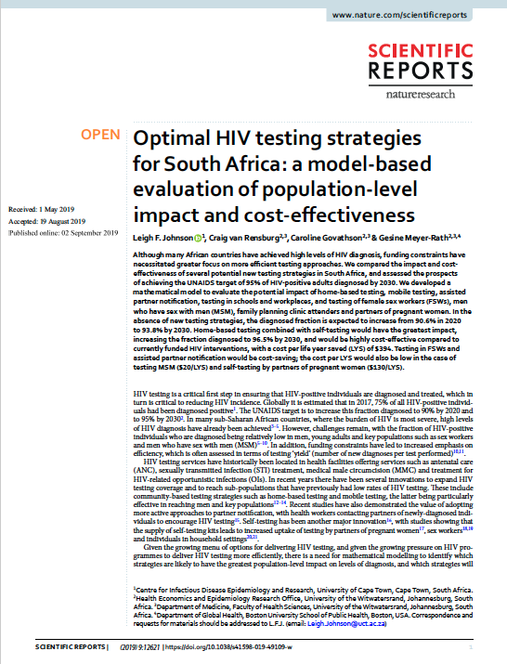
2. Leigh Johnson et al, 2019
Compared the impact and cost-effectiveness of several potential new testing strategies in South Africa
Home-based testing combined with self-testing would have the greatest impact
Testing in FSWs and assisted partner notification would be cost-saving
https://pubmed.ncbi.nlm.nih.gov/31477764/

Slide 11
https://pubmed.ncbi.nlm.nih.gov/31477764/
Notes:
The model estimates that over the 2010–2015 period, the HIV testing modalities that accounted for the greatest numbers of HIV tests were:
general HIV testing (63.0%),
testing in STI clinics (11.4%),
testing of OI patients (9.8%) and
antenatal testing (7.3%),
while the testing modalities that accounted for the greatest numbers of new HIV diagnoses were:
general HIV testing (43.6%),
testing of OI patients (32.5%),
testing in STI clinics (8.1%), and
testing partners of newly diagnosed individuals (7.4%)

Slide 12
As noted recently by De Cock and colleagues, there is a clear tension between pursuing the HIV testing strategies that are most efficient and the strategies that have the greatest impact10 strategies such as assisted partner notification, testing in FSWs and MSM, and secondary distribution of self-testing to partners of pregnant women were highly cost-effective (possibly even cost-saving) but had only a very modest impact on population-level HIV incidence and mortality. In contrast, home-based HIV testing was predicted to have the most substantial impact on HIV incidence and mortality, but at the expense of relatively low yields and cost-effectiveness. “
https://pubmed.ncbi.nlm.nih.gov/31477764/

Slide 13
Although South Africa is already close to the 90% diagnosis target in adults, South Africa is unlikely to achieve the 95% target by 2030 in the absence of major changes to HIV testing programmes, and strategies such as home-based testing may be crucial to achieving this. The challenges that South Africa faces in reaching the 95% target are to some extent a reflection of the challenges that the country faces in reducing HIV incidence, as the fraction diagnosed can only be increased substantially if the annual number of new diagnoses exceeds the annual number of new infections.
https://pubmed.ncbi.nlm.nih.gov/31477764/

Slide 14
much of the modelled benefit of testing arises from retesting previously-diagnosed individuals who have either never linked to HIV care or dropped out of care. Although such retesting of previously-diagnosed individuals is often considered a ‘waste’ of scare testing resources, it may be important in facilitating linkage to care and (re)initiation of ART.”
https://pubmed.ncbi.nlm.nih.gov/31477764/

Slide 15
Our sensitivity analyses suggest that the cost per life year saved reduces significantly as the relative rate of testing in previously-diagnosed untreated individuals increases, and thus it is important to consider repeat diagnoses as well as new diagnoses.
https://pubmed.ncbi.nlm.nih.gov/31477764/

Slide 16
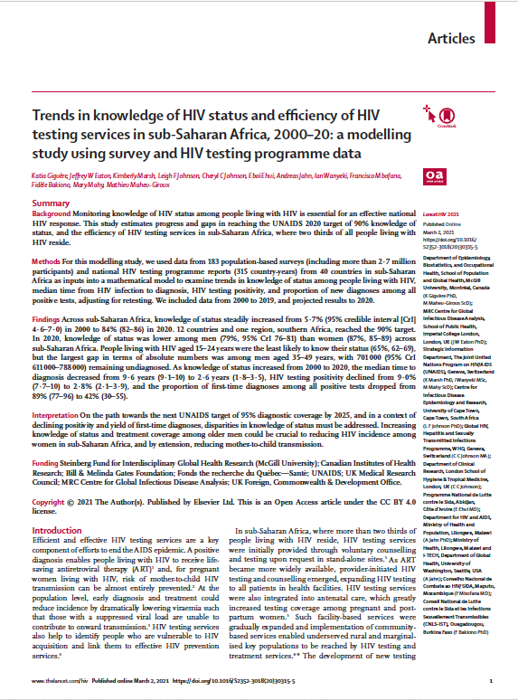
3. Giguère et al, 2021
Modelled first 90 data for 40 countries in sub-Saharan Africa between 2000-2019 (and projected 2020)
Across sub-Saharan Africa, increase in knowledge of status from 5.7% (2000) to 84% (2020)
Lower among men than women, younger (15-24 years of age) compared to older, largest gap in terms of absolute numbers was among men aged 35-49 years
SIDEBAR: MenStar focus is on men “especially those aged between 24-35”
https://pubmed.ncbi.nlm.nih.gov/33667411/

Slide 17
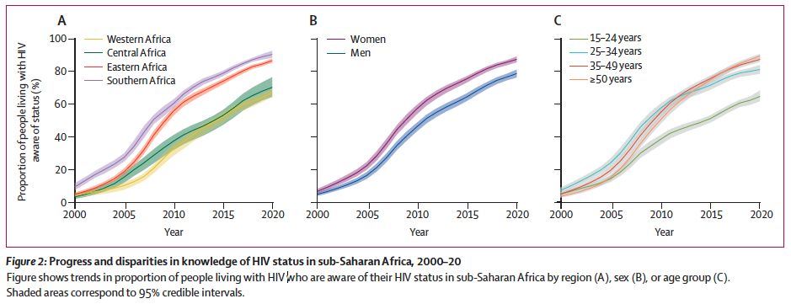
Projected disparities
While knowledge of status increased dramatically in all four sub-Saharan African regions, knowledge of status was consistently lower in western and central Africa than in eastern and southern Africa
Across sub-Saharan Africa in 2020, men had lower knowledge of status (77%) than women (87%), and 15-24 year olds were least likely to know their status (65%).
Only six countries projected to achieve 90% target in men by 2020, and none among 15-24 year olds.
https://pubmed.ncbi.nlm.nih.gov/33667411/

Slide 18
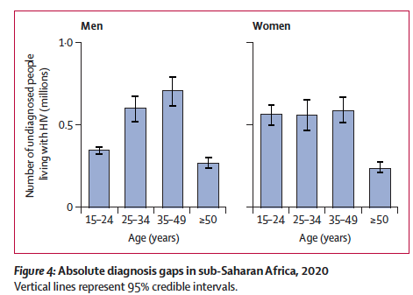
The largest group of undiagnosed people living with HIV in sub-Saharan Africa were men aged 35–49 years, with 701 000 left undiagnosed
https://pubmed.ncbi.nlm.nih.gov/33667411/

Slide 19
Project 58% of people living with HIV undergoing HIV testing in 2020 will have been previously diagnosed. Further research is needed to assess the potential benefits of retesting for re-engaging people living with HIV in care.
In conclusion - reaching the first 95 will require a better understanding of retesting patterns and a focus on addressing disparities among older men and young people in knowledge of status
https://pubmed.ncbi.nlm.nih.gov/33667411/

Slide 20
4. HTS_POS targets, Malawi
Striking difference between men and women

Slide 21
High yield among men 35-49 years across all Partners in Hope districts
Volume of men reached is the main challenge to target achievement in most age groups, not low yield
However, highest targets are among men 25-34 where the yield is lower

Slide 22
5. Reflection from Karen Jennings

